Slide 1
DevDoodle.net
A developer network
October 15, 2015
Brian Blair

Slide 2

Aims
Share code, get feedback
Learn new skills
Ask and answer questions
Create lasting repository of knowledge
}
Immediate benefits
Long-term help for search engine users

Slide 3
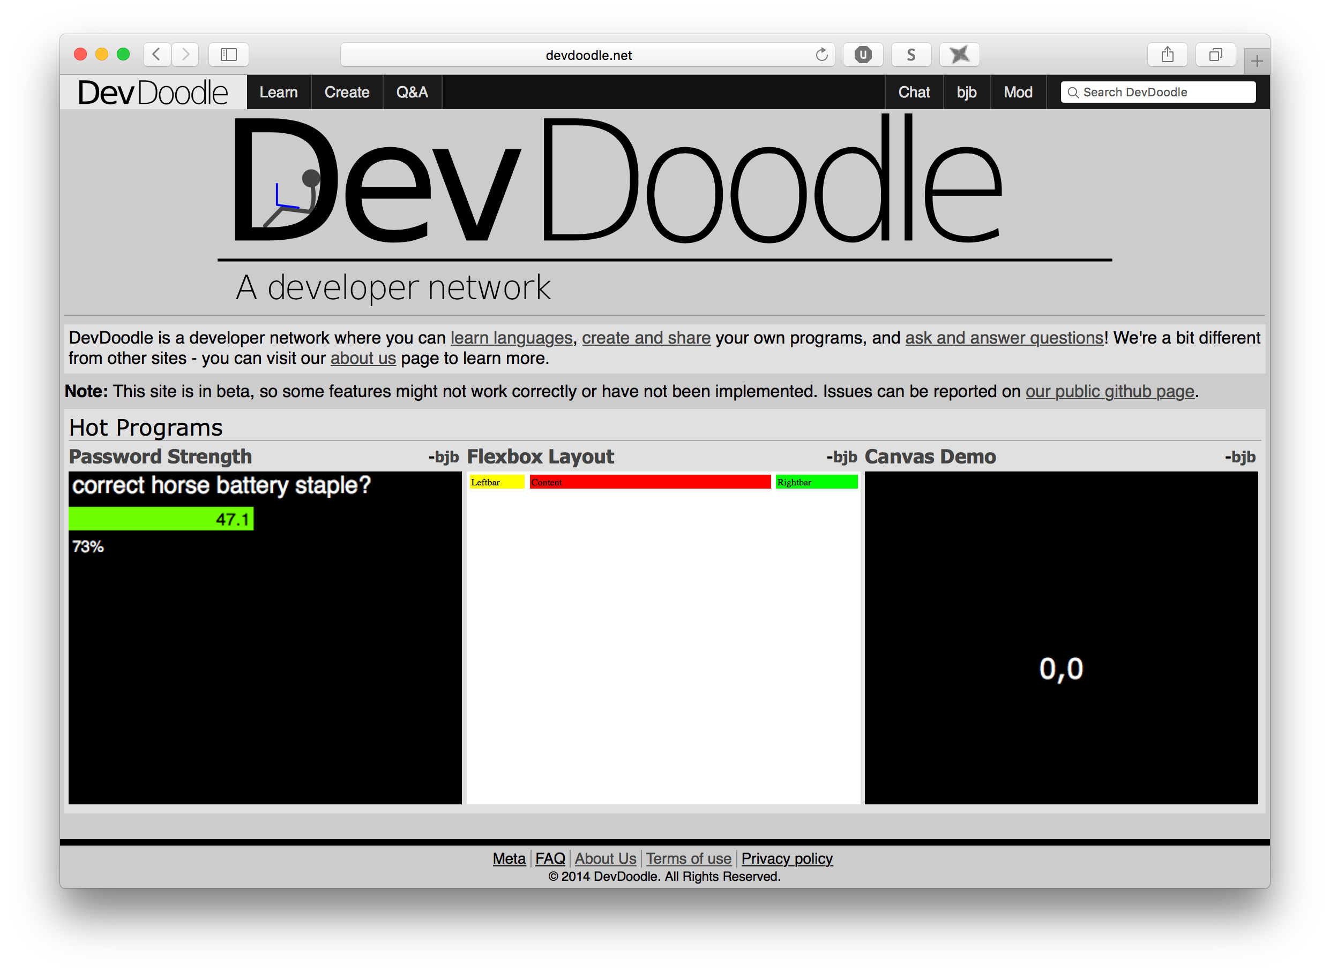

Slide 4
Competitors
Khan Academy
Corsera
Stack Overflow
Mozilla Developer Network
Codecademy

Slide 5
Competitors' Weaknesses
Incomplete product
Clash of user groups
Shallow tutorials, lack of advanced material
S:N

Slide 6
Target Users
Younger programmers
Some previous experience
Able to debug own code
eg, advanced high school CS students

Slide 7
Sections
Learn
Create
Q&A
Chat

Slide 8
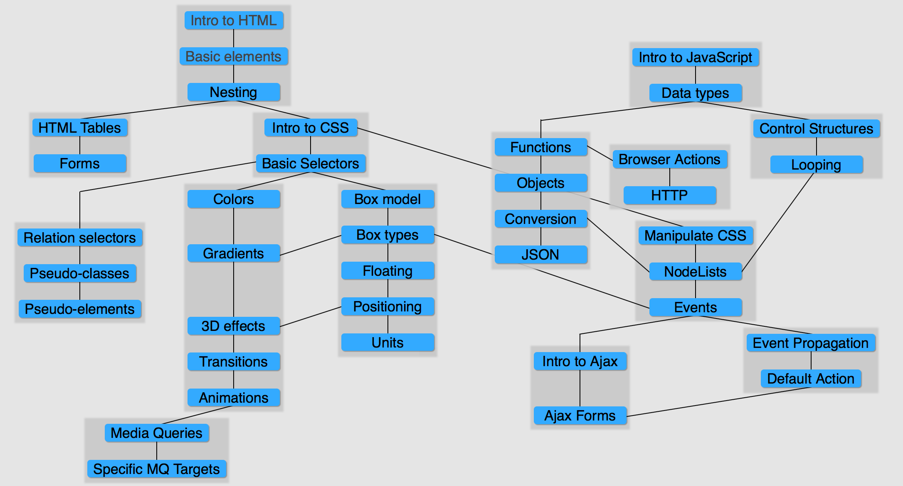
Sections
Learn

Slide 9
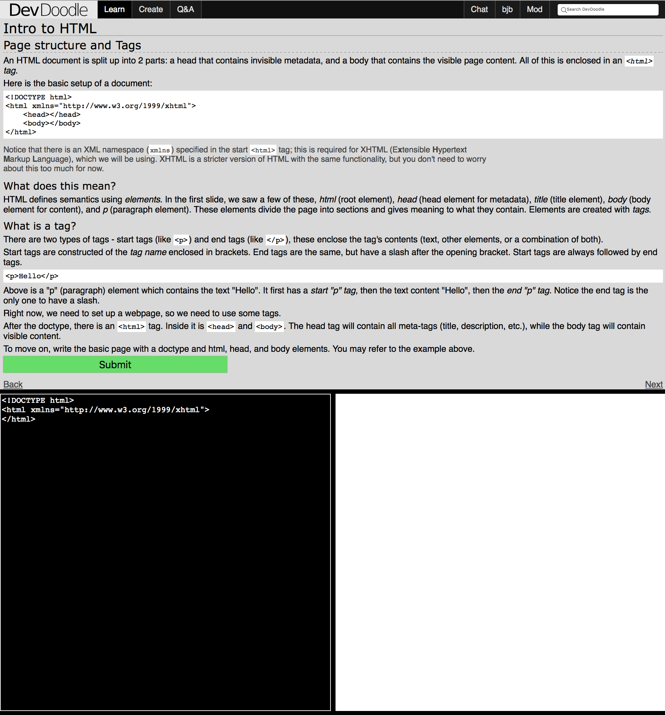
Sections
Learn
Create

Slide 10
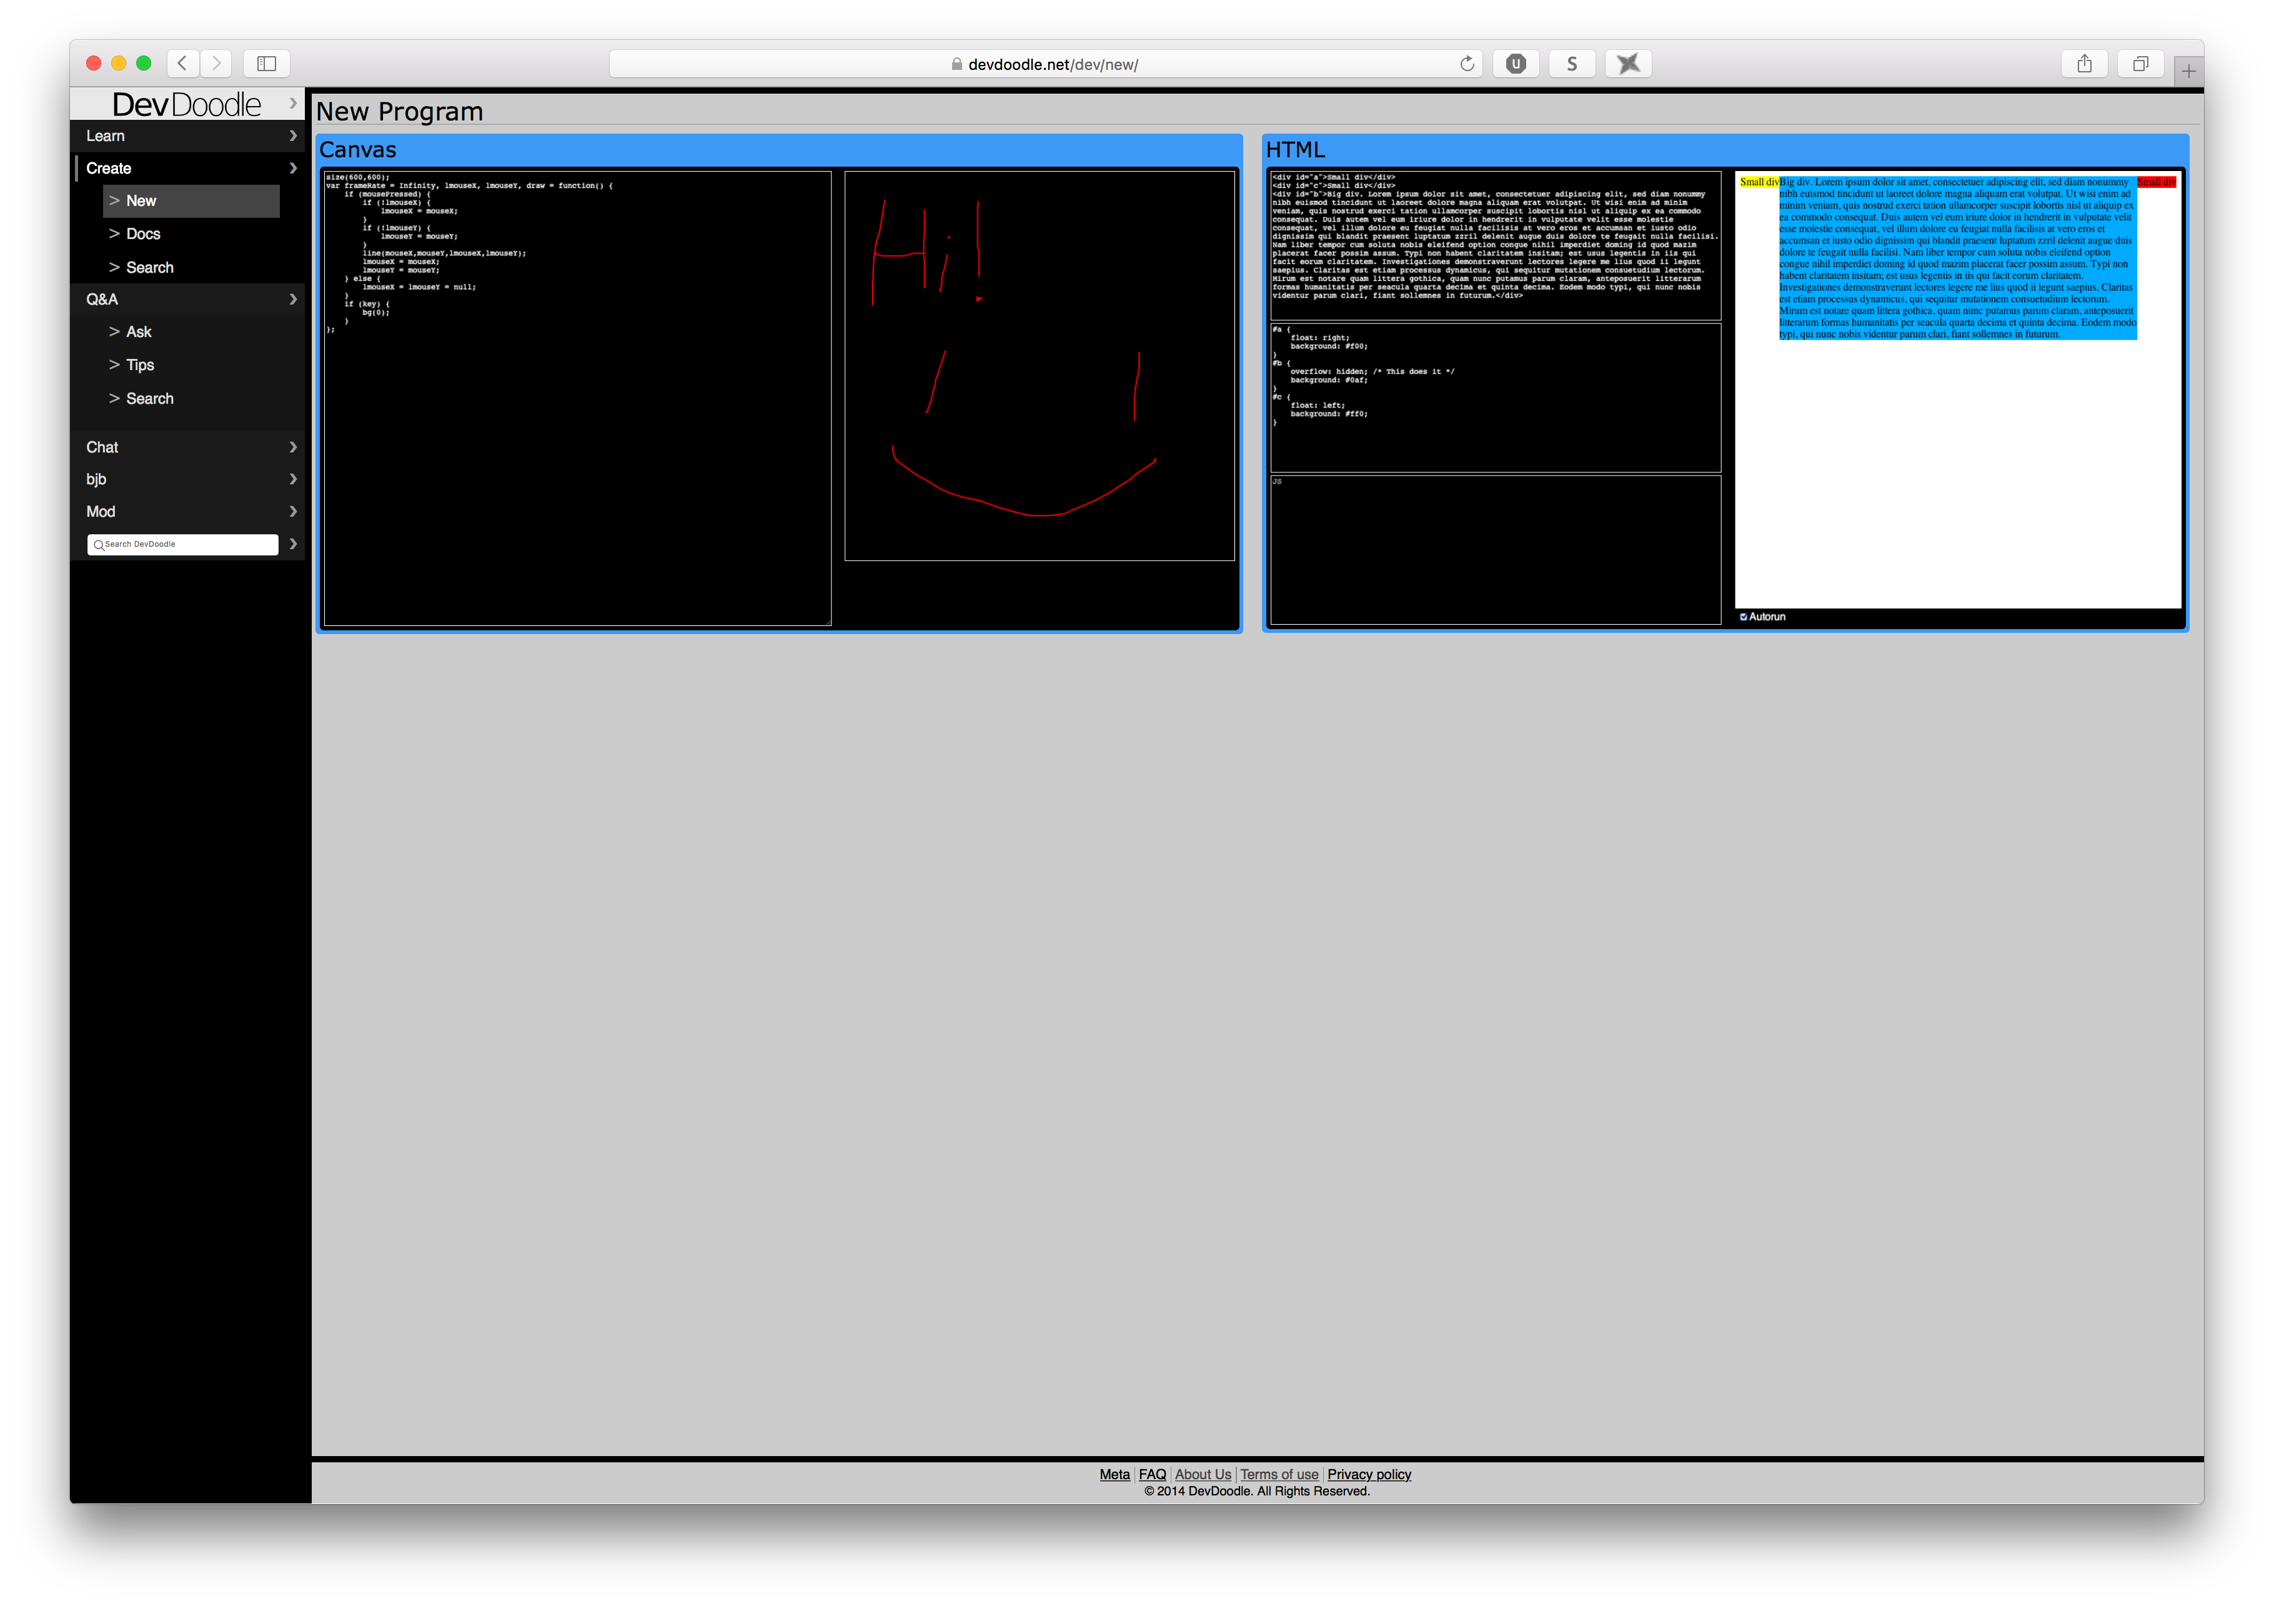
Sections
Learn
Create

Slide 11
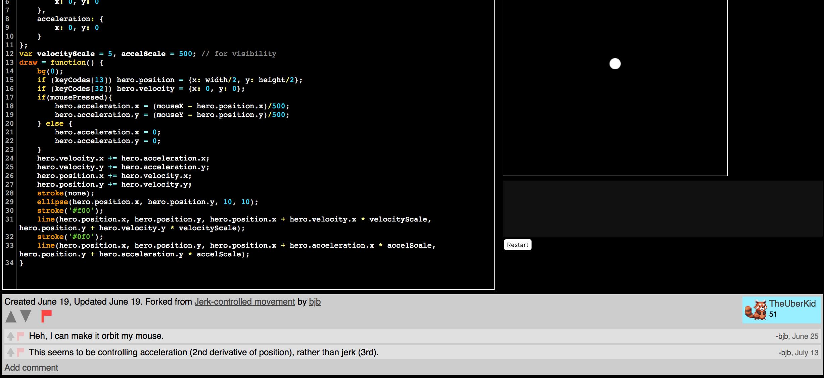
Sections
Create
Question & Answer

Slide 12
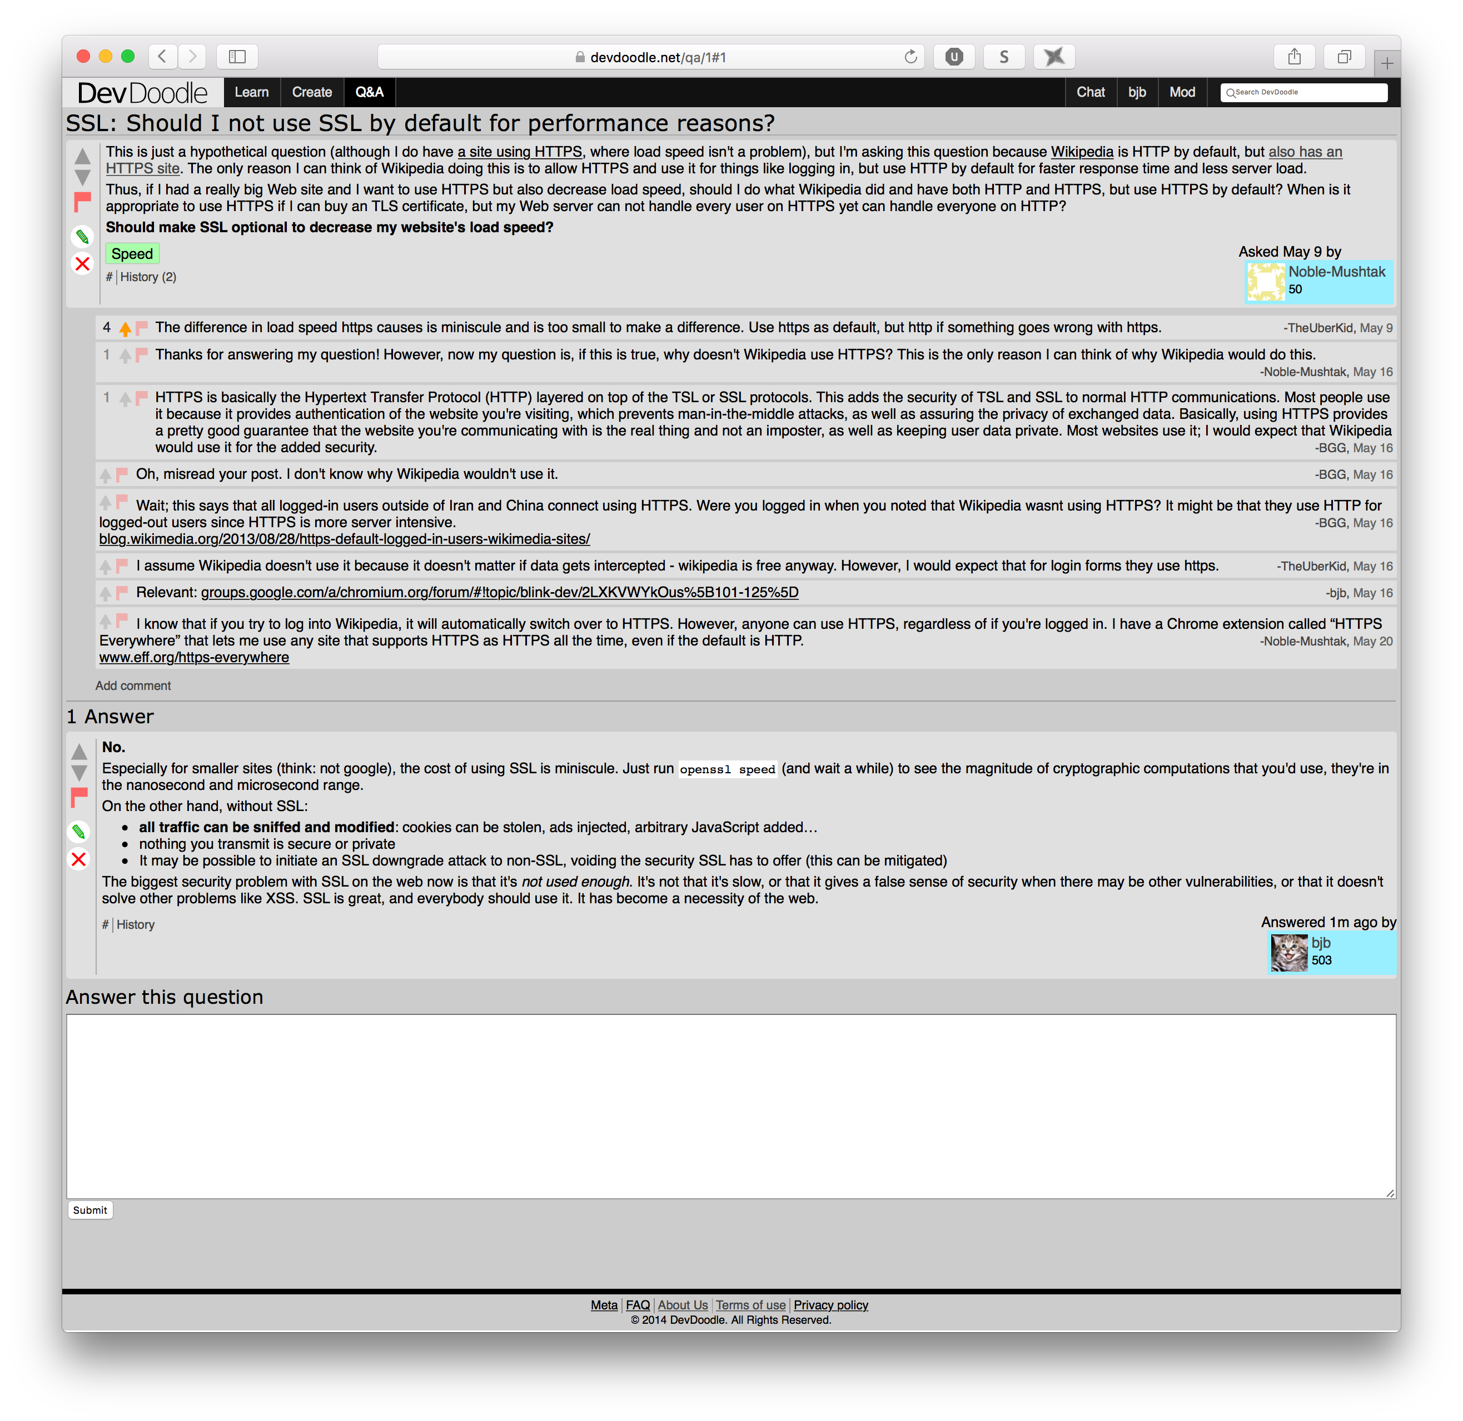
Sections
Create
Question & Answer
A focused question, not a request for help
Comments ask for clarification or give ideas
Potentially multiple answers, each share specific knowledge
(google juice!)

Slide 13
Sections
Question & Answer
General Reference Question (long, broad)
Specific questions (still not debugging)
MCVE
Linkage

Slide 14
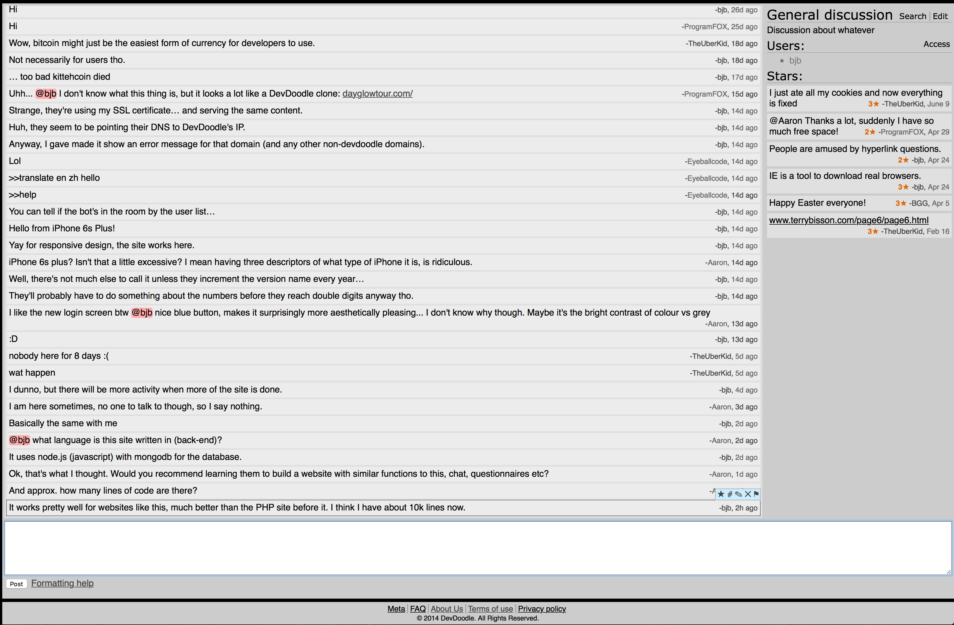
Sections
Question & Answer
Chat

Slide 15
Summary
Community culture and processes
Dichotomy of OP vs search engine user
Attention market; needs to incentivize
Self-sufficient; privilege system

Slide 16
DevDoodle
A developer network

